Slide 1

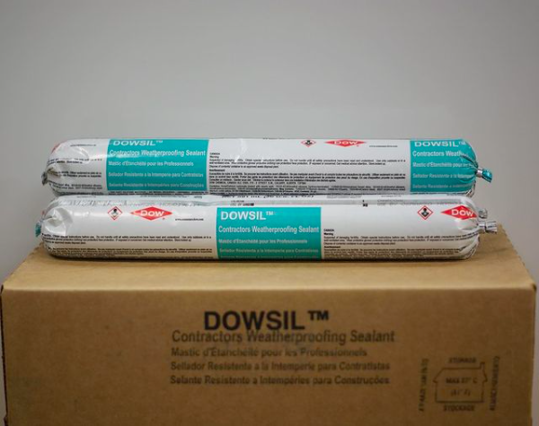

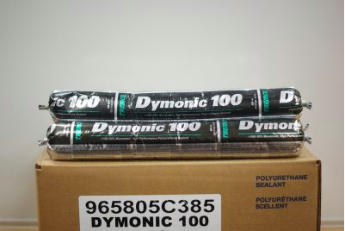
SILICONE VS POLYURETHANE CAULKING
WHAT’S THE DIFFERENCE?

Slide 2
POLYURETHANE CAULKING
Polyurethane is an organic compound
Water/Moisture & Corrosion-resistant
Provides excellent flexibility
Is Paintable
High Tear Resistance

Slide 3
SILICONE CAULKING
Is inorganic – which provide greater chemical resistance
Remain flexible over a wide temperature range
They are rarely affected by ultraviolet light & rain
It maintains adherence even when stretched or long
Do not crumble, crack or open like organic sealants
They present life expectancy three times higher than organic materials
It is not paintable

Slide 4
When to use Polyurethane Caulking
Use polyurethane caulk when you are caulking to wood or surfaces that must be painted.
Be aware of the fact that is will adhere very well to most surfaces but it will not hold up as well as silicone caulk in high sunlight exposure.

Slide 5
When to use Silicone Caulking
Adheres very well to almost any material but it does not adhere well to wood surfaces.
Also, silicone caulk is not paintable, so be careful about where you use it.
It is ideal for wet or exterior surfaces because it holds up well in sunlight and extreme temperatures.

